Slide 1

Working Capital Management
(Unit IV)
Dr.M.Velavan
Faculty
School of Management
SASTRA Deemed University
Thanjavur – 613 401

Slide 2
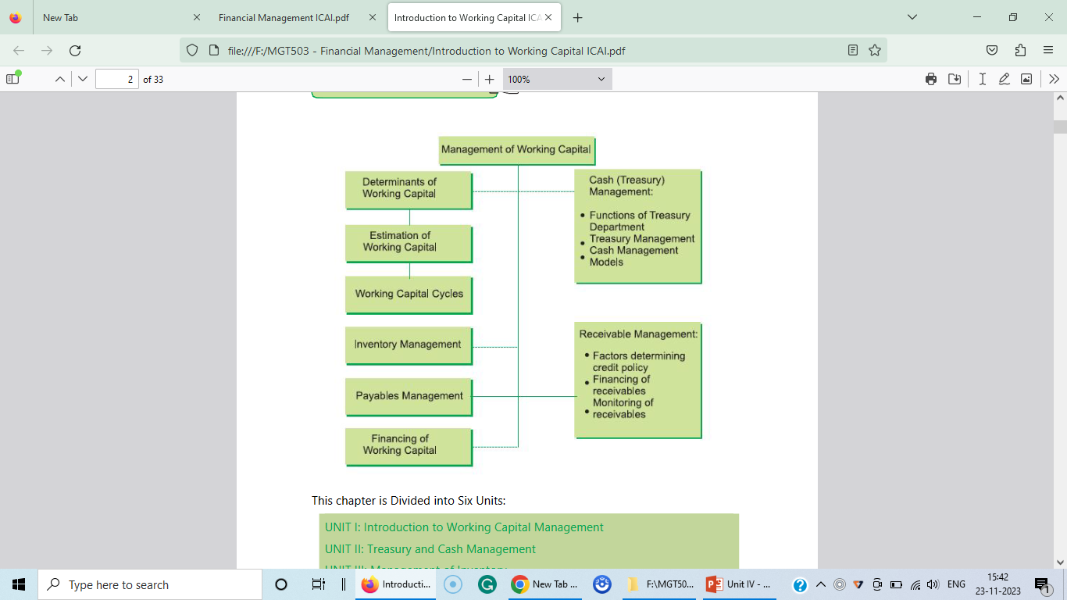
Overview:

Slide 3
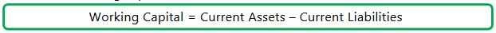
1. Meaning:
In accounting terms, working capital is defined as the difference between current assets and current liabilities. If we break down the components of working capital we will find working capital as follows:

Slide 4
2. Definition of Working Capital:
Working capital refers to the circulating capital required to meet the day-to-day operations of a business firm. Working capital may be defined by various authors as follows:
1. According to Weston & Brigham - “Working capital refers to a firm’s investment in short-term assets, such as cash, amounts receivables, inventories etc.
2. Working capital means current assets. —Mead, Baker, and Malott.
3. “The sum of the current assets is the working capital of the business” - J.S.Mill
Working capital is defined as “the excess of current assets over current liabilities and provisions”. However, as per accounting terminology, it is the difference between the inflow and outflow of funds.

Slide 5
3. Working Capital Management:
It is a process that is designed to ensure that an organization operates efficiently by monitoring & and utilizing its current assets and current liabilities to the best effect. The primary objective is to enable a company to maintain sufficient cash flows in order to meet its day-to-day operating expenses and its short-term obligations.

Slide 6
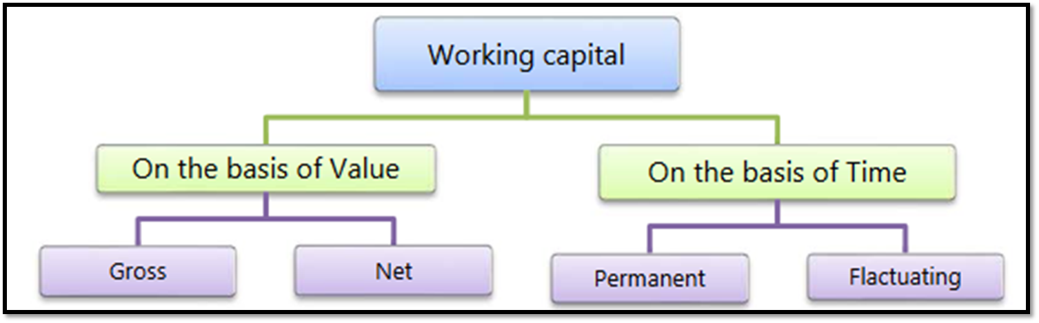
The concept of working capital can also be explained through two angles.

Slide 7
a) Gross working capital:
It refers to the firm’s investment in current assets [Total Current Assets].
b) Net working capital:
It refers to the difference between current assets and current liabilities [Current Assets-Current Liabilities].
d) Permanent working capital:
It refers to the base working capital, which is the minimum level of investment in the current assets that is carried by the entity at all times to carry out its day-to-day activities. It generally stays invested in the business, unless the operations are scaled up or down permanently which would also result in an increase or decrease in permanent working capital. It is generally financed by long-term sources of finance.

Slide 8
e) Temporary working capital:
It refers to that part of total working capital, which is required by an entity in addition to the permanent working capital. It is also called variable or fluctuating working capital which is used to finance the short-term working capital requirements which arise due to fluctuation in sales volume. For instance, an organization would maintain increased levels of inventory to meet increased seasonal demand.

Slide 9
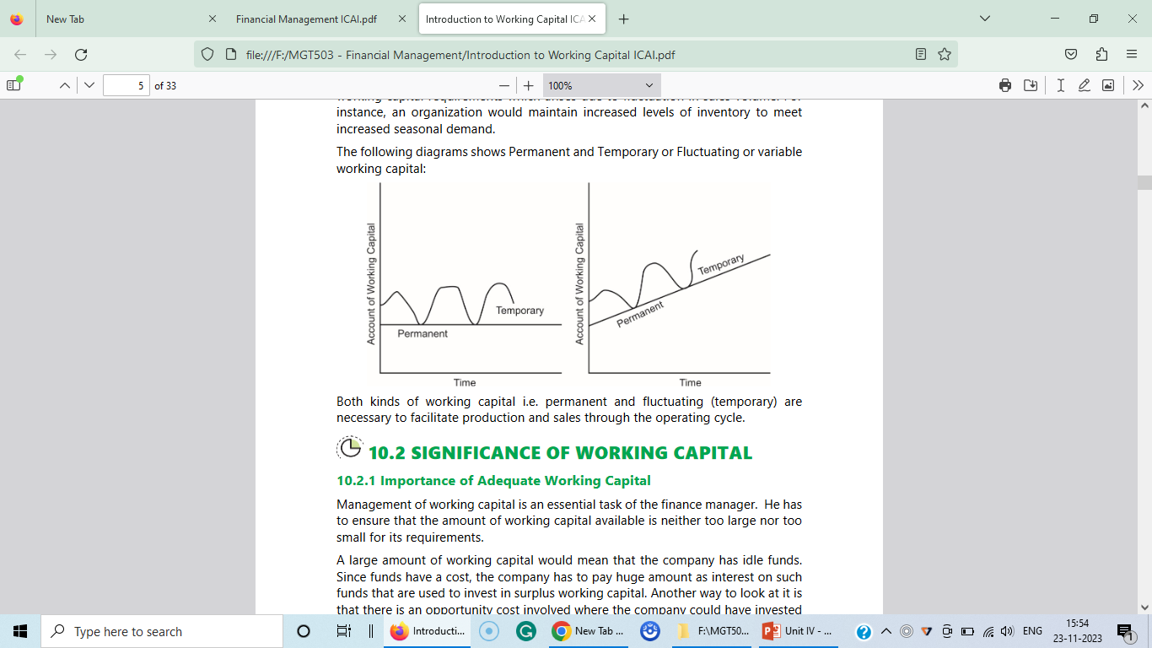
The following diagrams show Permanent and Temporary or Fluctuating or variable working capital:

Slide 10
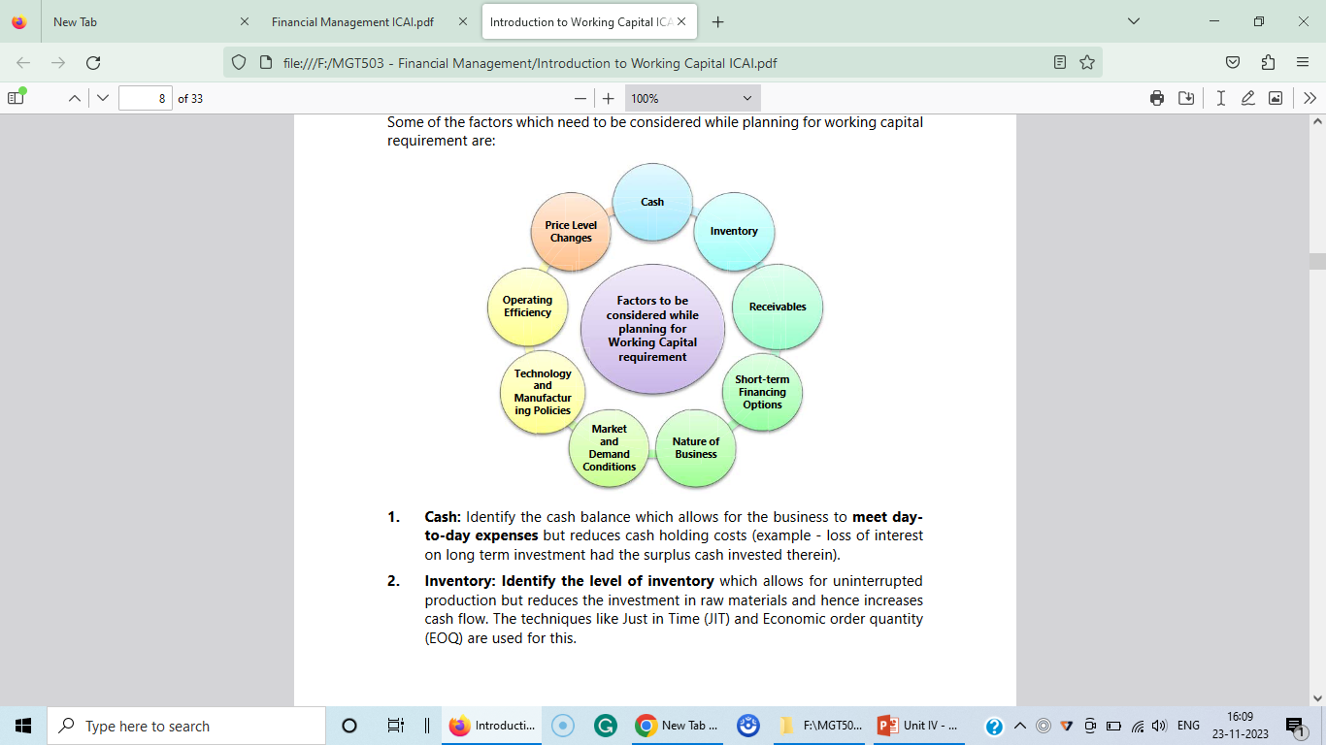
4. Determinants of Working Capital:

Slide 11
5. Management of Working Capital:
The importance of working capital for an entity can be compared to the importance of life blood for a living body or of lubricant/ fuel for an engine. Working capital is required for the smooth functioning of the business of an entity as lack of this may interrupt the ordinary course of activities. Hence, the working capital needs adequate attention and efficient management.
When we talk about management, it involves 3 Es i.e. Economy, Efficiency, and Effectiveness, and all these three are required for working capital management.
The scope of working capital management can be grouped into two broad areas: (i) Liquidity and Profitability and (ii) Investment and Financing Decisions.

Slide 12
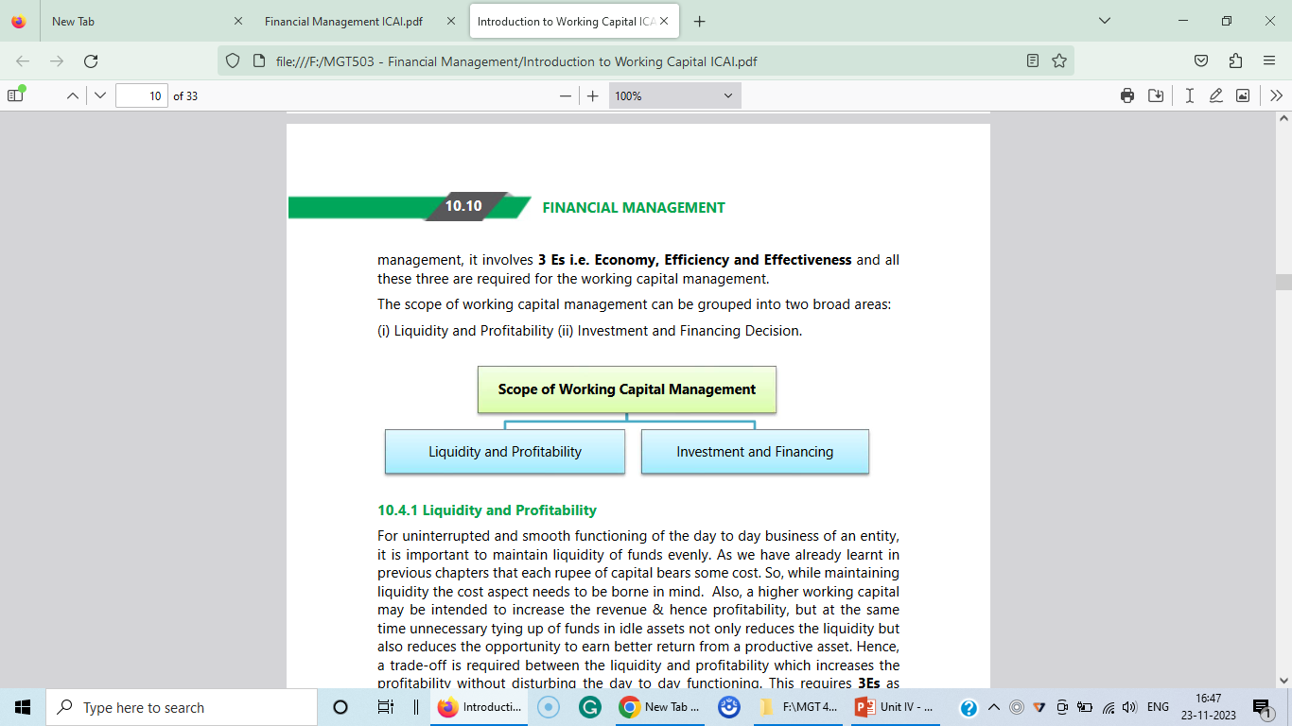

Slide 13
6. Estimating Working Capital Needs:
Operating cycle is one of the most reliable methods of Computation of Working Capital.
a) Operating or Working Capital Cycle:
Working Capital cycle indicates the length of time between a company’s paying for materials, entering into stock, and receiving the cash from sales of finished goods. It can be determined by adding the number of days required for each stage in the cycle. For example, a company holds raw materials on an average for 60 days, it gets credit from the supplier for 15 days, the production process needs 15 days, finished goods are held for 30 days, and 30 days credit is extended to debtors. The total of all these, 120 days, i.e., 60 – 15 + 15 + 30 + 30 days is the total working capital cycle.

Slide 14
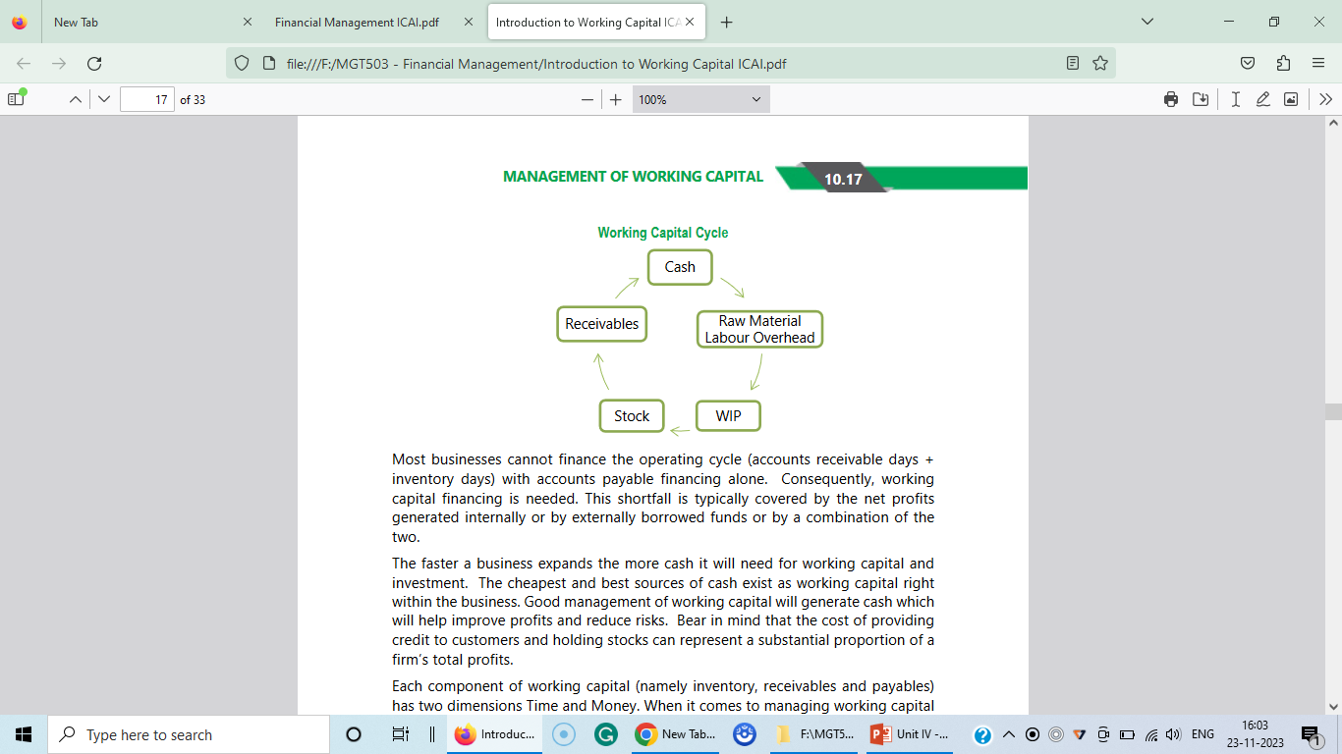

Slide 15
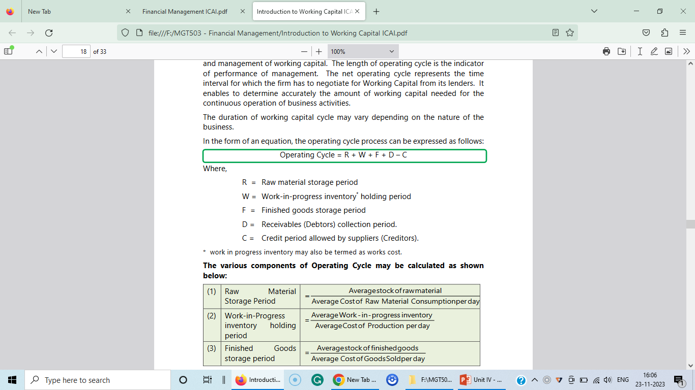
The duration of the working capital cycle may vary depending on the nature of the business.
In the form of an equation, the operating cycle process can be expressed as follows:
Where,
R = Raw material storage period
W = Work-in-progress inventory * holding period
F = Finished goods storage period
D = Receivables (Debtors) collection period.
C = Credit period allowed by suppliers (Creditors).
* work in progress inventory may also be termed as works cost.

Slide 16
Each of the components of the operating cycle can be put as follows:
R = (Average stock of raw materials held/Average consumption per day)
W = (Average stock of WIP maintained/Average cost of production per day)
F = (Average stock of finished goods / Average cost of goods sold per day)
D = (Average book debts/Average credit sales per day)
C = (Average trade creditors/Average credit purchases per day)
After computing the period of one cycle calculate the following:
Number of operating cycle in a year:
= 365/ Number of operating days in a cycle
b) Working capital requirement per cycle:
= Total operating expenditure/Number of operating cycle in a year.

Slide 17
P1.From the following information, extracted from the books of a manufacturing company, compute the operating cycle in days and the amount of working capital required:
Particulars | Rs.
Period covered | 365 days
Average period of credit allowed by suppliers | 16 days
 | [Rs.in ‘000]
Average total of debtors outstanding | 480
Raw material consumption | 4,400
Total production cost | 10,000
Total cost of sales | 10,500
Sales for the year | 16,000

Slide 18
Particulars | Rs.
Value of average stock maintained:
Raw material | 320
Work in progress | 350
Finished goods | 260

Slide 19
Solution: Computation of operation cycle
 | Particulars | No. of days
1. | Raw material held in stock: = (Average stock of raw materials held/Average consumption per day) = 320/(Rs. 4,400/365] | 27 days
2. | Work-in-progress: = (Average stock of WIP maintained/Average cost of production per day) = 350/[Rs. 10,000/365] | 13 days
3. | Finished goods held in stock: = (Average stock of finished goods / Average cost of goods sold per day) = 260/[Rs. 10,500/365] | 9 days

Slide 20
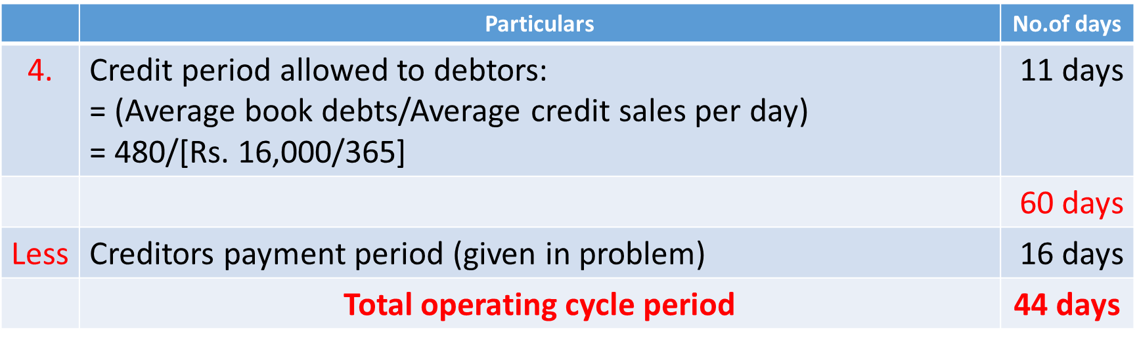
a) Number of operating cycle in a year:
= 365 days/44 days = 8.30
b) Amount of working capital required:
= Total operating cost/No. of operating cycle in a year
= Rs. 10,500/8.3 = Rs. 1,265

Slide 21
P2. The following information is available for ABC Limited.
Balance Sheet Data:
Beginning of 20X5 End of 20X5
Inventory 300 310
Accounts receivable 180 170
Accounts payable 85 95
Profit and Loss Account Data for the year ending 20X5:
Rs.
Sales 3,000
Cost of Goods Sold 1,800
What is the duration of the cash cycle?
Answer: 65 Days

Slide 22
Thank You

